Slide 1
Implementation Report
CSN-371 Artificial Intelligence
Modified Distance Metric That Generates Better Performance For The Authentication Algorithm Based On Free-Text Keystroke Dynamics
Mohammad Haaziq Jamal 22114055
IIT Roorkee

Slide 2
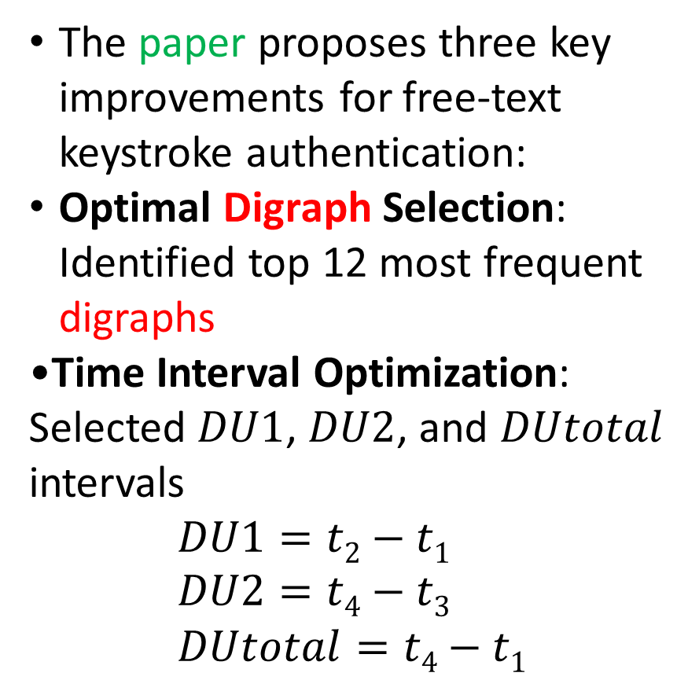
Literature Review
The paper proposes three key improvements for free-text keystroke authentication:
Optimal Digraph Selection: Identified top 12 most frequent digraphs
Time Interval Optimization: Selected $DU1$, $DU2$, and $DUtotal$ intervals $DU1=t2−t1$ $DU2=t4−t3$ $DUtotal=t4−t1$
K
D
t
t₁
t₂
t₃
t₄
K- Dwell time
K-D Flight time
D- Dwell time

Slide 3
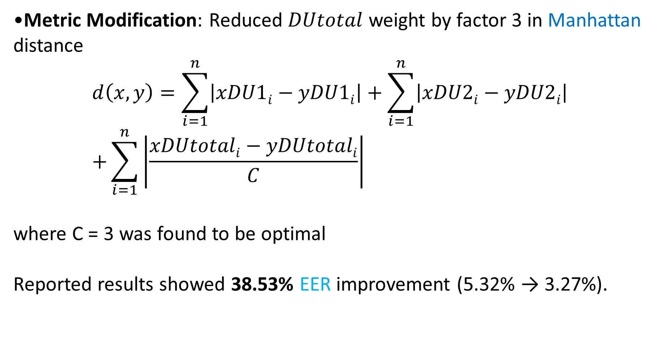
Literature Review
Metric Modification: Reduced $DUtotal$ weight by factor 3 in Manhattan distance $d\left(x,y\right)=\sum_{i=1}^{n}{\left|xDU1i−yDU1i\right|}+\sum_{i=1}^{n}{\left|xDU2i−yDU2i\right|}$ $+\sum_{i=1}^{n}{\left|\frac{xDUtotali−yDUtotali}{C}\right|}$
where C = 3 was found to be optimal
Reported results showed 38.53% EER improvement (5.32% → 3.27%).

Slide 4
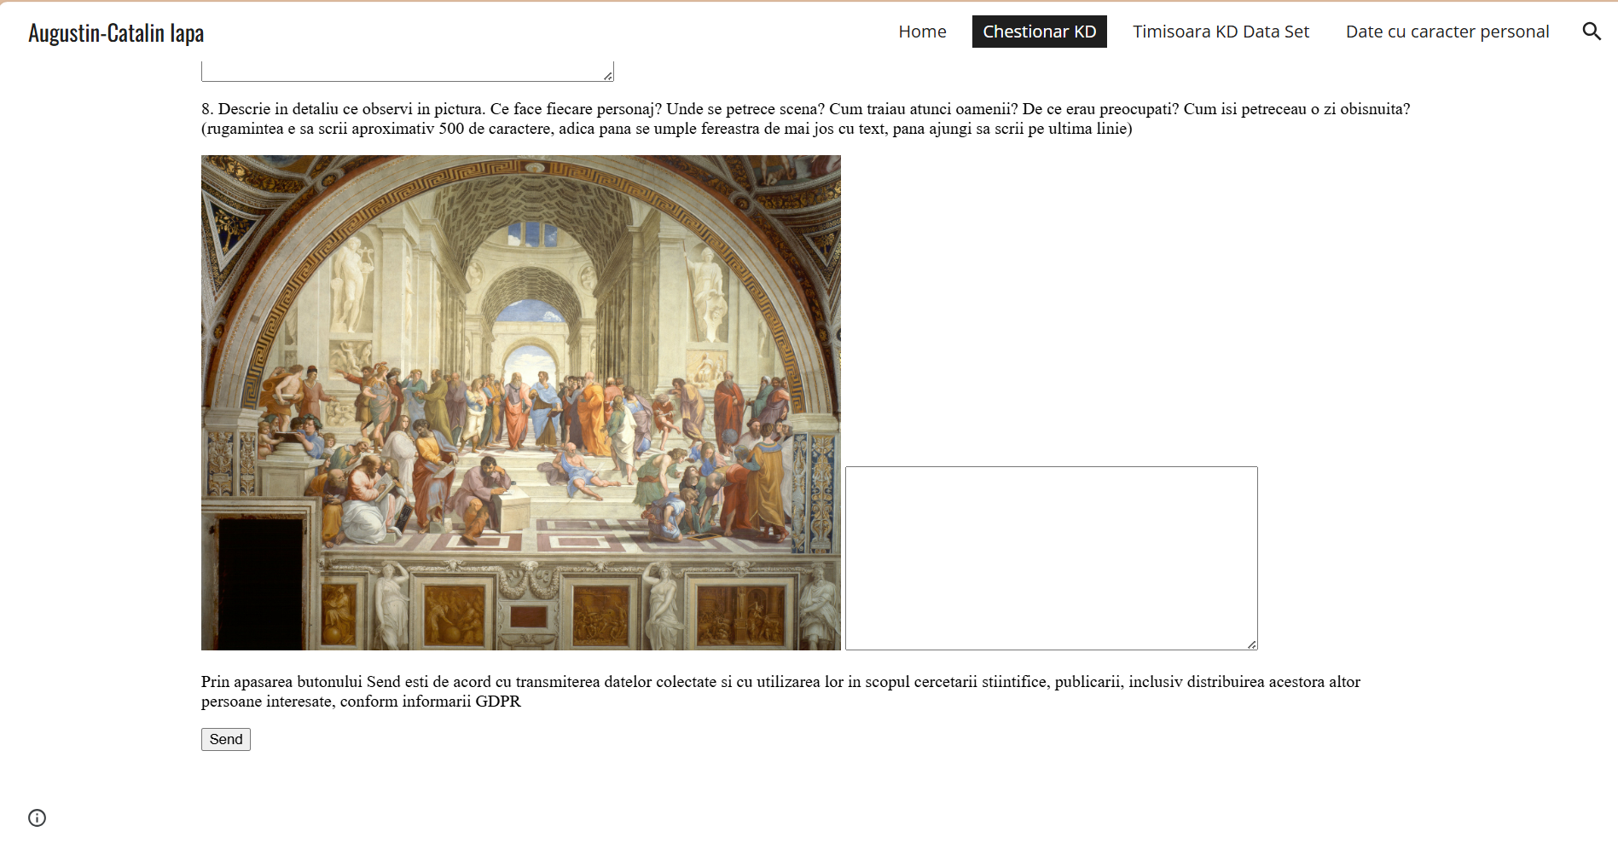
Dataset
Given in different paper “Shared Data Set for Free-Text Keystroke Dynamics Authentication Algorithms “
80 users (35M/44F/1 unspecified)
410,633 key events (200,299 typed keys)
Romanian language free-text input
1000-key sequences (160 total segments)
Fig.The platform for data acquisition

Slide 5

Implementation methodology
Code was developed to validate the paper's results, adhering to its parameters and making necessary assumptions where specifics were omitted.
Data Processing
Parse raw logs (key codes, timestamps)
Segment into 1000-key blocks
Extract digraphs & timing features
(DU1, DU2, DUtotal)
Feature Extraction
Select top 12 frequent digraphs (global)
Build vectors: mean(DU1/DU2/DUtotal)
NaN for missing digraphs
Metrics
Standard Manhattan
Modified Manhattan:DUtotal/3 weighting
Distance = $\sum{|feature differences|}$
Authentication
Leave-one-out evaluation
Threshold sweep(FAR/FRR sweep)
EER at $FAR=FRR$

Slide 6
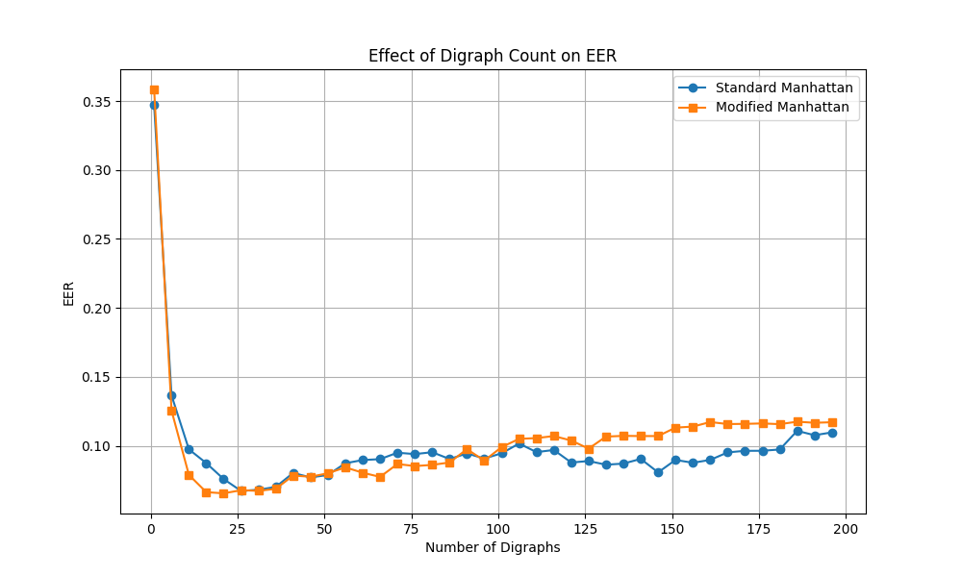
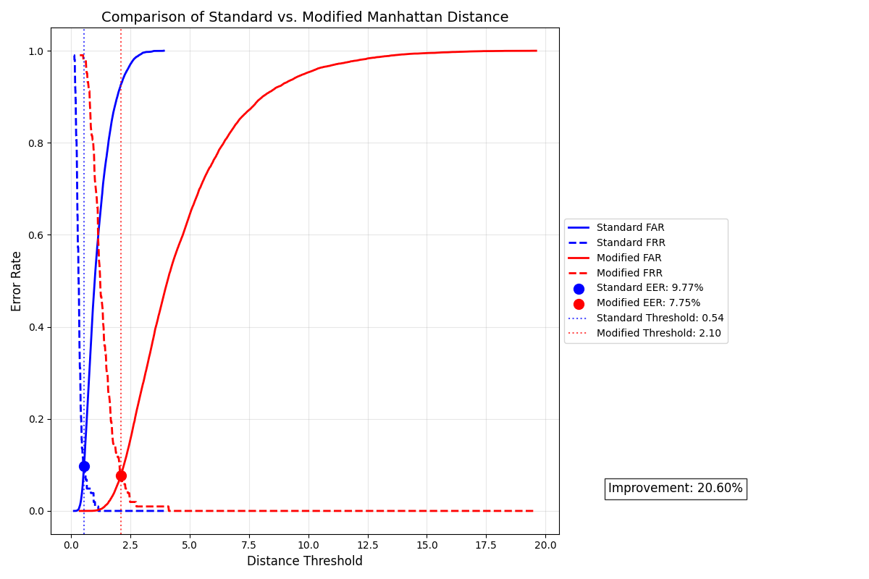
Results
EER Comparison Between Distance Metric
Digraph Count Analysis

Slide 7
Results
20.6% relative EER improvement with modified metric.
Metric | Our EER | Paper’s EER
Standard Manhattan | 9.77% | 5.32%
Modified Manhattan | 7.75% | 3.27%

Slide 8
Discussion
Discrepancy Factors:
Ambiguous Data Segmentation: The paper divides data into 1000-key sequences but does not specify how partial or short sequences are handled, leading to possible differences in implementation.
Unspecified Threshold Selection: Details on selecting threshold ranges and granularity for EER calculation are omitted, making this step open to interpretation.
Unclear Feature Aggregation: The paper refers to averaging keystroke times per di graph but does not state whether mean or median is used, nor how missing di-graphs are handled, affecting feature consistency.

Slide 9
Implementation Adjustments
Compared both mean and median for feature aggregation, finding median more robust.
Dynamically set threshold ranges based on observed distance values.
Tried IQR-based outlier removal to stabilize feature vectors.
Tested various normalization methods (Z-score, min-max, decimal scaling), with Z-score giving the best results.
These adjustments notably reduced EER, but remaining discrepancies with the papers reported results may be due to differences in dataset handling, feature extraction, or thresholding approach

Slide 10
Thank you!

Slide 11
References
Augustin-Catalin Iapa and Vladimir-Ioan Cretu. Modified distance metric that generates better performance for the authentication algorithm based on free-text keystroke dynamics. IEEE 15th International Symposium on Applied Computational Intelligence and Informatics, 2021.
Augustin-Catalin Iapa and Vladimir-Ioan Cretu. Shared data set for free-text keystroke dynamics authentication algorithms. Preprints, 2021.

